Slide 1
Kerberos Pt 2
“Advanced” Scenarios
ITP370
Spencer Harbar
Bob Fox
Notes:
SPENCE

Slide 2
About the speakers...
Spencer Harbar, MVP, MCTS, MCSD.NET, MCAD, MCSE, APM
  www.harbar.net
  Enterprise Architect working with some of Microsoft’s largest customers deploying Office SharePoint Server 2007.
  15 years in Enterprise IT
  ISPA Board Member
Bob Fox, MVP, MCTS
  bobfox.securespsite.com
  IT Professional with over 15 years experience
  Specializing in SharePoint architecture and deployment
  ISPA Board Member

Slide 3
Agenda
Load Balancing
Shared Services
Search
Excel Services
Additional Tools
Announcing Configuration Wizard
Q&A / Discussion

Slide 4
Load Balancing
Many “myths” surrounding Load Balancing
SharePoint Web Application Configuration
  Cnames (again!)
  Configure host name/host headers correctly
Load Balancers don’t know or care about Kerberos

Slide 5
Implementing Kerberos for SHAREPOINT
Web Applications

Slide 6
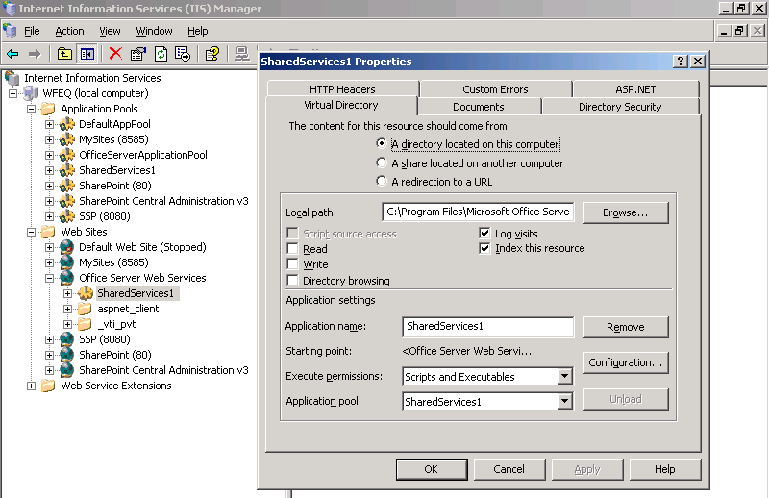
Shared Services
Stsadm.exe –o setsharedwebserviceauthn -negotiate

Slide 7
Shared Services
  .NET client can’t bind to the server using non default ports
    without host headers
    SSP services binding to the server using non default ports without host headers
  The indexer can’t crawl Kerberos web applications on non default ports

Slide 8


Shared Services
Office Server
Web Services
HTTP/server1 domain\user1
SharedServices1
Duplicate SPN’s
HTTP/server1 domain\user2
SharedServices2
Stsadm.exe
–o setsharedwebserviceauthn -negotiate

Slide 9
Shared Services Solution
Install Infrastructure Updates (or later) on all servers in farm
Add Registry Key
HKLM\Software\Microsoft\Office Server\12.0\KerberosSpnFormat = 1
Reboot!
SPNs for each machine
MSSP/server1:56737/SharedServices1 domain\user1
MSSP/server1:56738/SharedServices1 domain\user1
Configure Shared Services
Stsadm.exe –o setsharedwebserviceauthn -negotiate

Slide 10
Shared Services
You cannot mix and match NTLM and Kerberos
  In the same Farm
  All SSPs must either NTLM or Kerberos

Slide 11
SHARED SERVICES

Slide 12
Excel Services
When using with Analysis Services
  Additional Configuration
  MSOLAPSvc.3/HOST domain\user
  MSOLAPSvc.3/HOST:instance domain\user
  Middle Tier Delegation
  MSKB 917409
stsadm.exe -o set-ecssecurity -ssp %SSPNAME%
-accessmodel delegation

Slide 13
EXCEL SERVICES

Slide 14
Testing and validation
Don’t test from DC or Web Server!
Windows Security Auditing
Kerberos Auditing
Kerbtray and Klist
Netmon and Fiddler (etc)
IIS Log Files, IIS7 Failed Request Tracing
Above all, be patient!
  Use IISRESET

Slide 15
Kerberos Auditing
HKEY_LOCAL_MACHINE\SYSTEM\CurrentControlSet\Control\Lsa\Kerberos\Parameters\LogLevel
  Value Type: REG_DWORD
  Value Data: 1
  Do not leave on!!

Slide 16
Kerberos Debug View
HKEY_LOCAL_MACHINE\SYSTEM\CurrentControlSet\Control\Lsa\Kerberos\Parameters\KerbDebugLevel
Type: DWORD
Data: c0000043
  this value will print the most standard set of debug messages. Try it first. If you still want to see more output, set it to ffffffff.
Value: LogToFile
Type: DWORD
Data: 1
  C:\Windows\System32\lsass.log

Slide 17
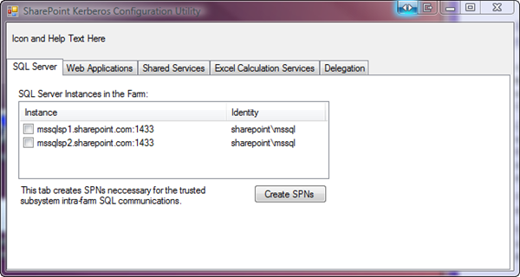
Announcing...
Kerberos Configuration Wizard

Slide 18
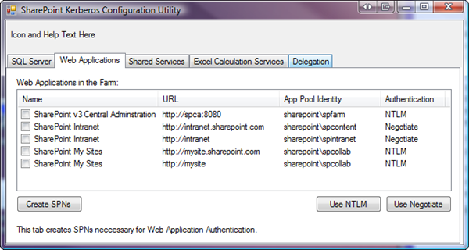
Kerberos Configuration Wizard

Slide 19
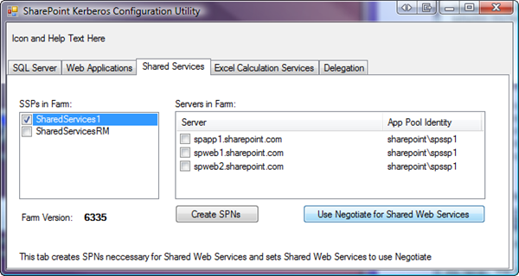
Kerberos Configuration Wizard

Slide 20
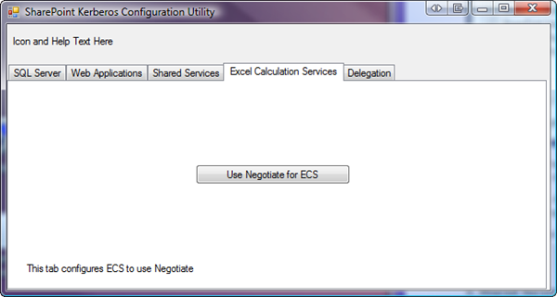
Kerberos Configuration Wizard

Slide 21
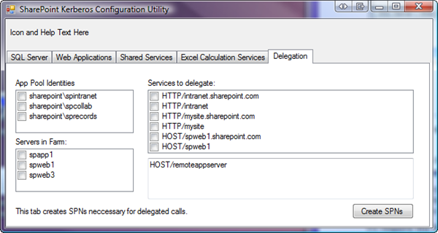
Kerberos Configuration Wizard

Slide 22
Recommendations
Windows 2008 if at all possible
Infrastructure Updates
NTLM first, then enable Kerberos
Patience!
Script configuration after extensive testing

Slide 23
Essential Tools
CLI: Setspn.exe
  Windows 2003: part of Resource Kit or separate download
  http://www.microsoft.com/downloads/details.aspx?familyid=9d467a69-57ff-4ae7-96ee-b18c4790cffd
GUI: Adsiedit.msc
  Windows 2003: part of support tools (on Windows CD)
Kerbtray.exe
http://www.microsoft.com/downloads/details.aspx?familyid=4E3A58BE-29F6-49F6-85BE-E866AF8E7A88
Klist.exe
http://www.microsoft.com/DownLoads/details.aspx?familyid=1581E6E7-7E64-4A2D-8ABA-73E909D2A7DC
  Both part of the Windows 2003 Resource Kit Tools
  http://www.microsoft.com/downloads/details.aspx?familyid=9d467a69-57ff-4ae7-96ee-b18c4790cffd
Network Monitor 3.2
http://www.microsoft.com/downloads/details.aspx?familyid=f4db40af-1e08-4a21-a26b-ec2f4dc4190d
DelegConfig
http://www.iis.net/downloads/default.aspx?tabid=34&g=6&i=1434

Slide 24
Common Issues
Issue
Best Practice
Mis-configured SPNs
Duplicate SPNs
PAC Validation
Host name issues
Load Balancing Myths
IE6 Clients use NTLM
Use correct notation!
Use new –X switch
Disable PAC Validation
Never use CNames!
Setup Web App Correctly
Don’t use CNames
  or MSKB 911149
DON’T USE ALIASES (Cnames) for Web Applications!

Slide 25
Takeaways
It’s easy!!
However, tons of misinformation and myths on the ‘net
  DCOM Configuration
  Delegation
  Dodgy Blog Posts!
The best links:
  Configure Kerberos authentication (Office SharePoint Server)
  http://technet.microsoft.com/en-us/library/cc263449.aspx
  Kerberos Authentication Tools and Settings
  http://technet.microsoft.com/en-us/library/cc738673.aspx
  Troubleshooting Kerberos Errors
  http://www.microsoft.com/downloads/details.aspx?FamilyID=7DFEB015-6043-47DB-8238-DC7AF89C93F1
  Ken Schaefer’s Blog
  http://www.adopenstatic.com/cs/blogs/ken

Slide 26


Thank you for attending!
Post conference DVD with all slide decks
Sponsored by

